Slide 1
Monuments, Memorials, & Commemorations
Notes:
Do you know what those words mean?
What’s a monument?
-- a structure, often made of stone, put in place to help people remember a person or event The Bennington Battle Monument in Bennington, Vermont exists to remember the Battle of Bennington.
What’s a memorial?
-- something to help people remember something – a day (Memorial Day), a monument (the Jefferson Memorial)
What’s a commemoration?
-- a ceremony or celebration to help people remember (the 4th of July, Battle Day, the Bennington Battle Day parade. Bennington Battle Day is an official Vermont State holiday, observed on August 16 each year.)
What do monuments, memorials, and commemorations have in common?
-- They help shape and preserve our memories of the past

Slide 2
The Monument Today
Notes:
This is a typical summer day at the Bennington Battle Monument. This photo was taken by a drone.
How many people visit the Monument every year?
-- more than 50,000. More than 30,000 of them ride the elevator up to the observation deck.
Where do all those people come from?
-- from all over the US, from all over the world

Slide 3
Another shot at sunset… so peaceful!

Slide 4
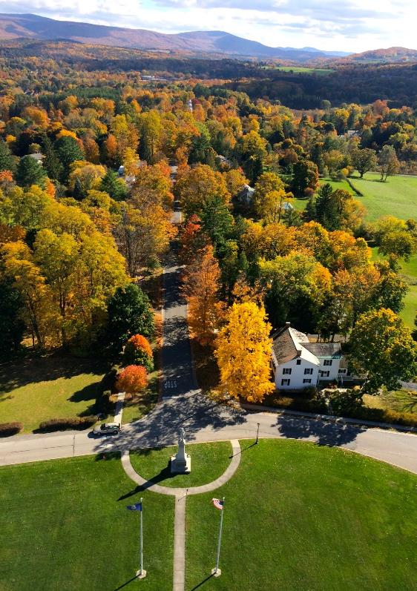
Spring and fall…

Slide 5
Visitors on Battle Day, 2014
Notes:
A page from the visitors book for August 16, 2014– Why do you think they come to visit the Monument?
-- it makes them think about American history and about how the United States came to exist
-- it’s an impressive work of architecture (or sculpture, if you prefer)
-- for the view from the “top”

Slide 6
Visitors in August 1915

Slide 7
Notes:
How much does it cost now?

Slide 8
Looking up Monument Avenue – 1900?
Notes:
How did it get to be there? Why was it made?
-- the last veteran of the Battle of Bennington died around 1850. Living memory had to become some other kind of memory. The people of Bennington founded a Association in 1853 to erect a monument to remember the Battle.
Why did they choose that spot?
-- that’s where the Continental storehouse was that the British wanted to raid.
What happened next?
-- not much until 1877.
Why is that date significant?
-- it was the centennial of the Battle, one year after the centennial of the nation
Who decided on the design of the Monument and how?
-- they formed a committee; they had a competition; they selected a design

Slide 9
The Winner!
Notes:
Here’s the winner! It’s about fifty feet high. That’s General Stark on top.
So what happened?

Slide 10
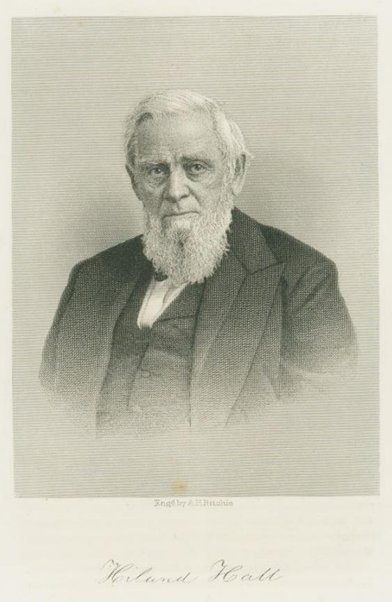
Hiland Hall
Notes:
Hiland Hall happened. Do you know who he was?
-- former Governor of Vermont, from Bennington; also a historian
He objected…
Why? – He thought a big battle should have a big monument, something “massive and lofty,” to use his very words.
He persuaded people to reopen the competition. A new design was selected.

Slide 11
The Tower design
Notes:
What do you think? It’s about 200 feet high. It was… modified.

Slide 12
Getting closer…
Notes:
Getting closer? Is that our Monument? What’s different?

Slide 13
Interior view
Notes:
How many stairs does it have?
-- 417 – it’s open to the public twice a year for climbing
Have you ever visited?
Have you ever seen anything like it?

Slide 14
The Concord Memorial, Concord, Mass.
Notes:
Built in 1836

Slide 15
Bunker Hill Monument, Charleston, Mass.
Notes:
221 feet tall, dedicated in 1843

Slide 16
Saratoga Battle Monument, Schuylerville, NY
Notes:
155 feet tall, finished in 1883
Where is Saratoga and when did the Battle of Saratoga take place?

Slide 17
The Washington Monument
Notes:
Finished in 1886 – 555 feet tall.
What do we call structures like this?
-- obelisks
Who designed and built the first obelisks?

Slide 18
Where do you think that is?
Notes:
Heliopolis obelisk
Built by the ancient Egyptians. This one was built (out of a single piece of granite) around 2750 BC

Slide 19
Where are we now?
Notes:
The Temple at Karnak
Those obelisks were dedicated to Ra, the god of the sun
Why do you think Americans erected so many obelisks in the 19th century?
-- they thought of them in connection with one of the world’s great early civilizations – and because America wanted to be one too
How much did the Monument cost?
-- $112,00 (in 1889 dollars), or about $2.5 million today
Who paid for it
-- the Federal government, the states of VT, NH, and Mass, and private individuals, including Vermont schoolchildren – like you
Who designed it?

Slide 20
J. Philip Rinn, architect
Notes:
J. Philip Rinn of Cincinnati.
Who built it?
-- a company from Lowell, Mass., but many of the workers came from Bennington and surrounding towns – perhaps some of your ancestors

Slide 21
Notes:
Where did the stone come from and how did they get it there?
-- from a quarry in Hudson, NY; by a special rail line (or spur) that led right to the building site (visible in photo)
What kind of stone is it?
-- limestone. And limestone is made of the shells and skeletons of tiny animals that once lived in the sea. Some of them were fossilized.

Slide 22
Fossils (south side)
Notes:
You can spot fossils in the stone at the monument.

Slide 23
Notes:
How did they build it?
-- the men “dressed” the blocks of stone, then put the blocks in place using cranes and pulleys
How many blocks did they need?
-- around 6,000
How much does each block weigh?
-- a lot
It was dangerous work. Did anyone die building the Monument?
-- Nope. But someone fell…and was soon back at work

Slide 24
Notes:
Higher and higher

Slide 25
Setting the capstone, 1889
Notes:
The final stone was put in place on November 29, 1889.
It was cold. It was windy!

Slide 27
Notes:
Monument staff climb this outer ladder in order to change the lightbulb at the top (which alerts airplanes to the monument’s existence)

Slide 28
Col. Seth Warner
Notes:
The statue of Seth Warner was added in 1910

Slide 29
“There they are, the Tories and the redcoats! We beat them today or this night Molly Stark sleeps a widow.” -- General John Stark
Notes:
John Stark was added in 1998

Slide 30
Molly Stark
Notes:
There is a statue of Molly Stark in Wilmington, Vermont, put in place in 2004

Slide 31
Capt. Elijah Dewey and his wives Eunice and Mary, Old First Church Cemetery
Notes:
These three gravestones can be found in the cemetery next to the Old First Church in Old Bennington. Have you ever been there?
It’s open to the public. There are many old stones there. What is the meaning of the flag and the marker?
-- Captain Elijah Dewey led troops from Bennington into the Battle under Colonels Warner and Herrick. His first wife died and he remarried. The flag is there because he’s a veteran and the marker because he fought in the Revolutionary War.

Slide 32
The common grave, Old Bennington Cemetery
Notes:
Here’s another monument or memorial in the same cemetery. It was put up in 1896 and it’s rather unusual. It’s where the bones of Americans who died from their wounds after the battle are buried (their homes were in New Hampshire), but not only them, it’s also where Germans who died of their wounds are buried. Their names were chiseled onto the stone marker in 1981, the Americans on the east, the Germans on the west. And on the north:

Slide 33
Hanged in 1778, buried in 1981
Notes:
David Redding was a Loyalist who was charged with helping the British in 1778 and who was hanged on the town green. His body was not allowed to be buried. His bones were kept by the town doctor for many years. They ended up in the collection of the Bennington Museum, and were finally buried in 1981 in the chest in which they had been kept for 203 years.
Does this monument have a meaning for you? If so, what is it?

Slide 34
Grandma Moses, The Battle of Bennington (1953)
Notes:
Who was Grandma Moses?
Why did she paint this picture?
Do you notice anything odd or out of place about it?

Slide 35
Notes:
Why do you think Grandma Moses included the Monument?

Slide 36
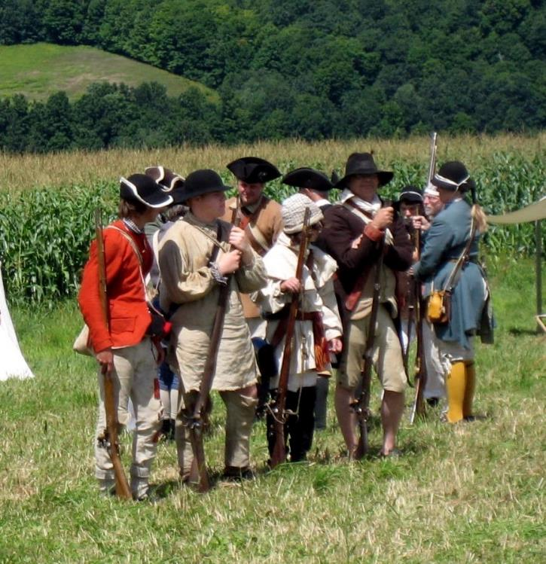
Re-enactors
Notes:
Sometimes people get dressed up and re-enact parts of the Battle

Slide 37
German grenadiers (reenactors)

Slide 38
Reenactment 2017

Slide 39
Battle Day, 1891
Notes:
The Monument was dedicated in August, 1891 after a parade through Bennington. President Harrison was there. So was a young man from Plymouth, Vermont, named Calvin Coolidge. What happened to him?
-- he became President in 1923
Was that triumphal arch made of real stone?
-- Nope: painted board. But it was strong enough to support “about 175 young ladies, and children from the public schools, singing patriotic songs”

Slide 40
Battle Day, 2017
Notes:
What word did we use to describe ceremonies and celebrations like Battle Day? What are they?
-- “commemorations”
Have you or your parents or other relatives ever marched in the parade?
There were big Battle Day celebrations in Bennington in 1877, 1891, 1927, 1977, and 1991. When is the next big one going to be?

Slide 41
Get ready for 2027!
How would you imagine celebrating Battle Day in 2027?
If you had to design a new monument to commemorate the Battle of Bennington, what would it look like?

